Slide 1
What is Truly Important for NBA Players?
Cole Woods

Slide 2
The Problem Statement
Why do only wholistic statistics and not the individualistic lead to trends of higher salaries?
The wholistic statistics show trends of increased rates of winning where as the individualistic statistics show no trends with rates of winning.

Slide 3
What Data am I Working With?
Win Shares
Player Efficiency Rating
Value Over Replacement Player
Box Plus/Minus Score
Assist Percentage
Usage Percentage
Turnover Percentage
Block Percentage
Total Rebounding Percentage

Slide 4
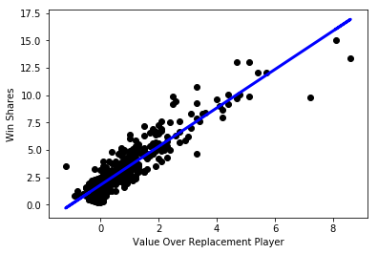
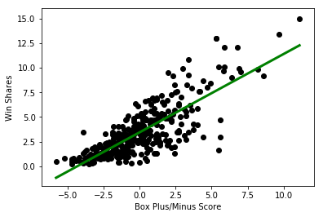
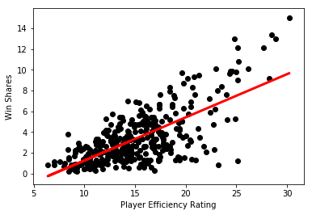
Visualizing the Wholistic Statistics

Slide 5
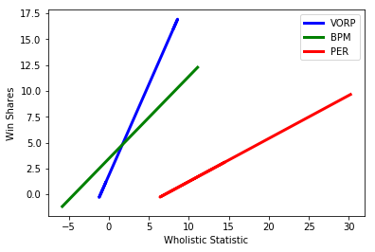
A Visualized Comparison of the Wholistic Statistics

Slide 6
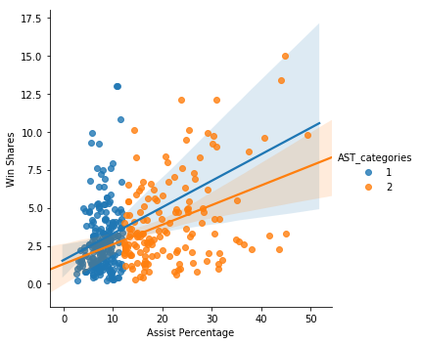
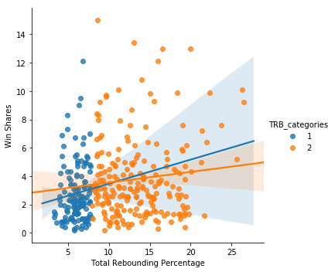
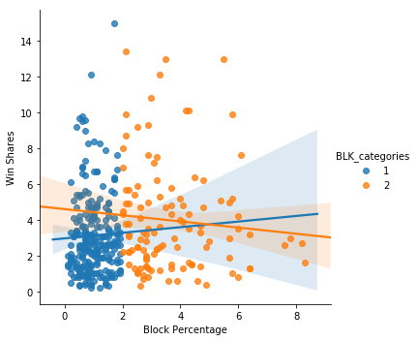
Visualizing the Individualistic Statistics Part 1

Slide 7
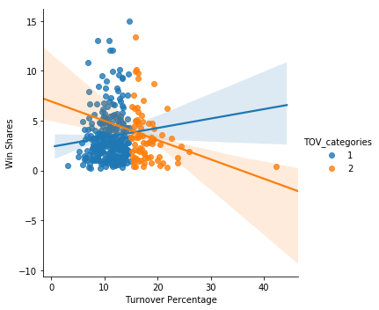
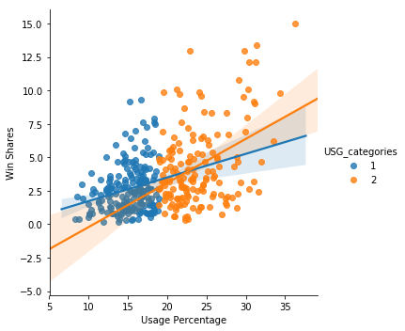
Visualizing the Individualistic Statistics Part 2

Slide 8
Conclusions from the Data
The wholistic statistics have a positive correlation in relation to win shares.
Value over replacement player is the best statistic to determine how impactful a player is to a team’s wins.
The individualistic statistics don’t show much of a correlation in relation to win shares.
Even in the statistics that don’t show much of a correlation in relation to win shares you can still see clusters of points in the bottom left corner meaning that being bad at anything in basketball can greatly affect your chance of effectively contributing to your team’s wins until a certain point.
Based on the four points above my new theory is that the well roundedness of a player is among the most important factors.

